Slide 1


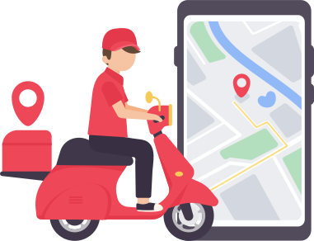


Level: Advanced
Comprehensive Data Analysis using SQL Zomato - A Food Delivery Company

Slide 2
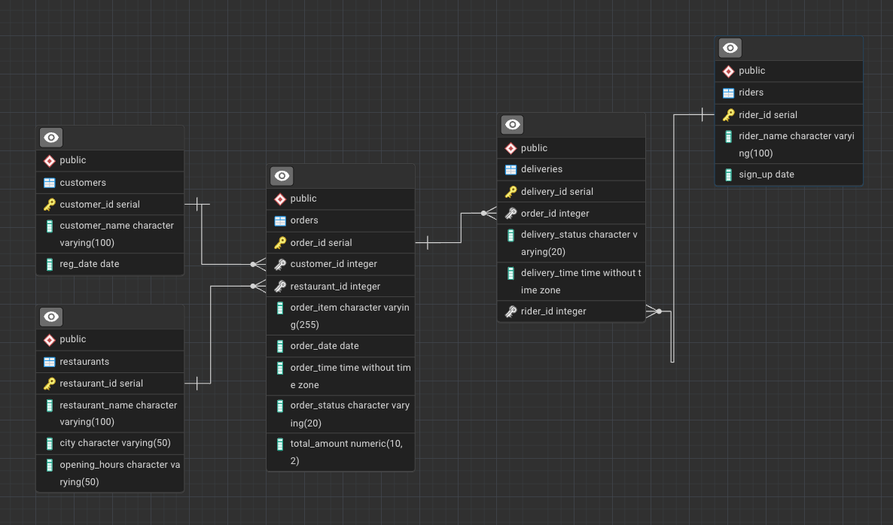

Database Setup (Snowflakes Schemas)

Slide 3
Topic you will learn in this project video
Database Creation and Table Design (Database concepts, constraints)
Data Retrieval and Filtering (Basics SQL)
Aggregations and Grouping
Joining Tables (Left Join, Inner Join)
Window Functions(Row Number, Rank, Dense Rank, Lead, Lag)
Date and Time Functions
Conditional Logic
Subqueries
Ranking and Ordering
Data Segmentation (CASE STATEMENT)

Slide 4
You will solve 20 critical business problems using SQL
You will write complex SQL queries which will showcase your problems solving and decision making skills!
Customer Behaviour and Insights
Order and Sales Analysis
Restaurant Performance
Rider Efficiency and Performance
Operational Effectiveness

Slide 5
Let’s start;

Slide 6
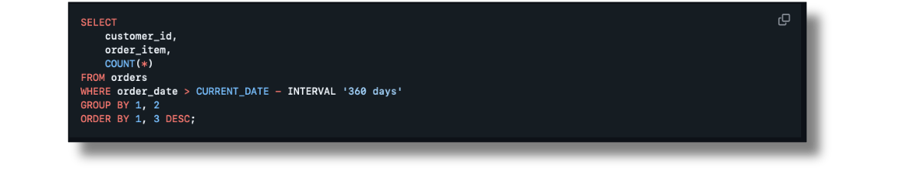
Business Problem 1
Top 5 Most Frequently Ordered Dishes
Find the top 5 most frequently ordered dishes by a specific customer in the last year.
Solution 1

Slide 7
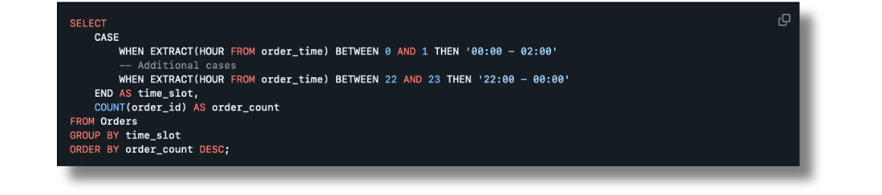
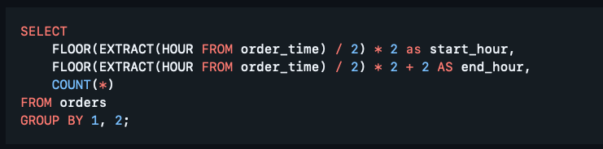
Business Problem 2
Popular Time Slots
Identify the time slots during which the most orders are placed, based on 2-hour intervals.
Solution 1
Solution 2

Slide 8
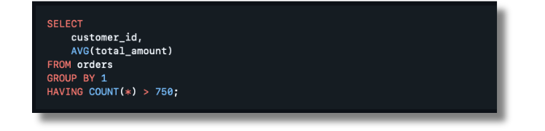
Business Problem 3
Order Value Analysis
Find the average order value per customer who has placed more than 750 orders.
Solution 1

Slide 9
Business Problem 4
Order Value Analysis
Find the average order value per customer who has placed more than 750 orders.
Solution 1

Slide 10
Business Problem 20
Orders Without Delivery:
Find orders that were placed but not delivered, and return the restaurant name, city, and the number of not delivered orders.
Solution 1

Slide 11
Conclusion
This project highlights my ability to handle complex SQL queries and provides solutions to real-world business problems in the context of a food delivery service like Zomato. The approach taken here demonstrates a structured problem-solving methodology, data manipulation skills, and the ability to derive actionable insights from data.

Slide 12
Thank you!

